Slide 1
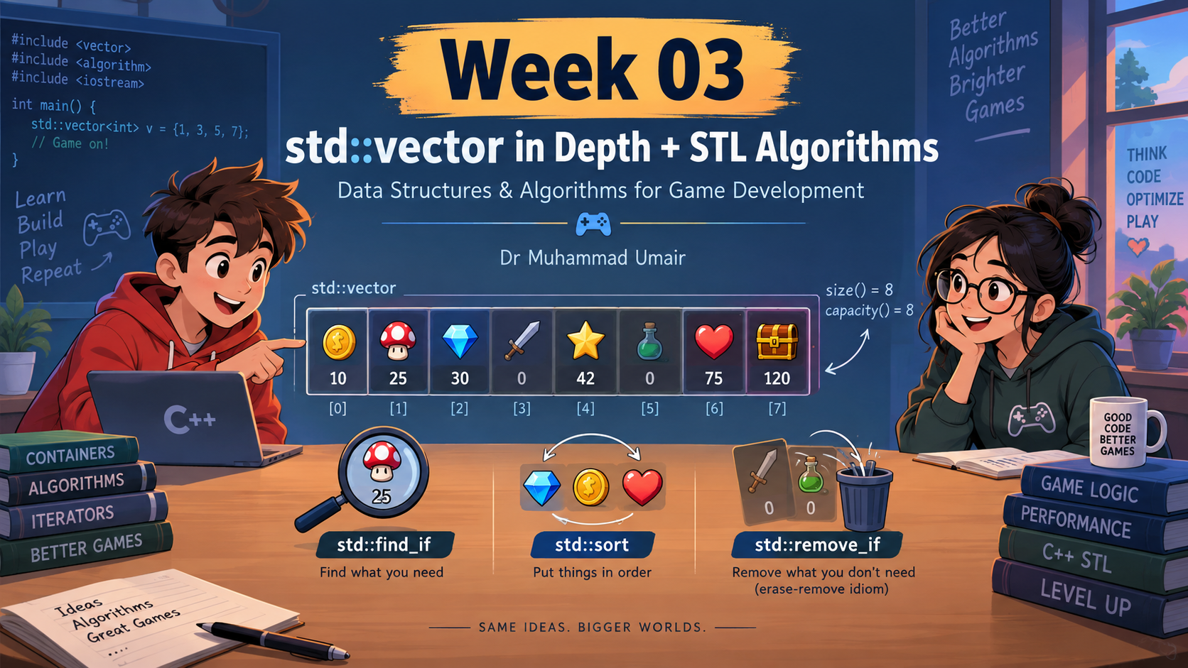

Slide 2
Content
1. Vector Fundamentals
Operations, element access and modification
2. Size & Memory
size(), capacity(), reserve() and resize()
3. Iterators
Traversing vectors and iterator invalidation
4. Searching with Conditions
find_if(), predicates and lambdas
5. Removing Elements
remove_if() and the erase–remove idiom
6. Game Development Application
Managing players, enemies and game objects using STL
Vector → Iterator → Lambda → Algorithm → Better Game Code
Store
Access
Grow
Search
Remove
push_back
insert
[] / at()
front / back
size
capacity
reserve
find_if
lambda
remove_if
erase

Slide 3
1. Vector Fundamentals
Operations, element access and modification
A std::vector stores elements in sequence and can grow or shrink dynamically while the program is running.
Think of it as an expandable row of game data.
std::vector<int> scores {50, 20, 80, 30};
🎮 Game Example
A vector can store active enemies, bullets, inventory items or scores.
When a new enemy appears:
scores
50
20
80
30
enemies.push_back(newEnemy);
[0]
[1]
[2]
[3]
The vector grows to include it.
Index positions
Add / Remove
Access
Modify
scores.push_back(90);
scores.pop_back();
scores[2]; scores.at(2);
scores.front(); scores.back();
scores[1] = 25;
Add or remove elements from the end of the vector.
Use an index or retrieve the first / last element.
Change the value stored at a selected position.
Takeaway: Vector gives indexed access like an array, but it can grow and shrink dynamically.
Notes:
Explain the slide in three stages:
1. Vector is an expandable ordered collection.
2. Show scores as boxes with indices and remind students indexing starts from zero.
3. Connect the methods to real game data: adding enemies, accessing scores, and modifying an element. Ask: what would happen when a new enemy appears during gameplay?

Slide 4
std::vector: More Than a Dynamic Array
Key idea: array-like access + flexible growth
A sequence container where order, position and growth matter
A vector is like an expandable row: it keeps elements in order, lets us jump to any index, and grows when new data is added.
Vector stores values in a continuous, indexed sequence
①
Order is preserved
Index
0
1
2
3
4
Items stay in the same sequence until we change them.
scores
→
10
20
30
40
50
60
push_back(60)
②
Position gives access
scores[2] jumps directly to the value at index 2.
std::vector<int> scores {10, 20, 30, 40, 50};
③
Growth is automatic
push_back() can add new elements while the program runs.
Common operations
Access
Check state
Add / remove
[] at() front() back()
size() empty() capacity()
push_back() pop_back()
change the end of the vector
read values using positions
inspect how much data / space exists
🎮 Game example:
A vector can store active enemies, bullets, inventory items or scores. When something new appears, add it; when it disappears, remove it.
Notes:
Suggested click-through explanation:
1. Start with the one-sentence definition: vector is an expandable row.
2. Explain the visual row: values are kept in order and each value has an index.
3. Ask students: what is scores[2]? Then reveal/direct attention to 30.
4. Point at the dashed new box to show how push_back adds a new element.
5. End with the operation strip and connect it to game objects: enemies, bullets, inventory, scores.

Slide 5
Building a Vector Step by Step
Adding and removing values at the back
Visual trace
std::vector<int> scores;
scores.push_back(50);
scores.push_back(80);
scores.push_back(40);
scores.pop_back();
Start
push_back(50)
50
push_back(80)
50
80
push_back(40)
50
80
40
pop_back()
50
80
Notes:
Demonstrate push_back and pop_back. Ask students whether pop_back removes from the front or back.

Slide 6
Accessing Elements
Different ways to read values from a vector
Build 1/2
Index
50
80
40
90
First element
scores[0]
Reads the element stored at index 0.
Last element
scores[3]
If size is 4, the last valid index is 3.
scores →
0
1
2
3
How to read a vector
A vector stores values in order. Each value has a position called an index, and indexing starts from 0.
Think like this
Position 1st → index 0
Position 2nd → index 1
Position 3rd → index 2
Game example
A vector could store player scores, enemy health values or collected items.
Key idea: index tells us where to look, and the index always starts at 0.

Slide 7
Accessing Elements
Different ways to read values from a vector
Build 2/2
Index
50
80
40
90
scores →
0
1
2
3
Using index
scores[0]
Fast way to get the first element.
Checked access
scores.at(0)
Also gets the first element, but checks whether the index is valid.
Front element
scores.front()
Directly returns the first element in the vector.
Back element
scores.back()
Directly returns the last element in the vector.
Which one should I use?
• Use [] when you already know the index is valid. Use at() when you want safer checked access.
• Use front() and back() when you specifically need the first or last element.
All four methods read values, but they are used in slightly different situations.

Slide 8
Size ≠ Capacity
Two numbers students often confuse
size = 4
capacity = 8
0
1
2
3
4
5
6
7
10
20
30
40
used elements
prepared empty space
size()
How many elements currently exist?
capacity()
How many elements can fit before more storage may be needed?
Notes:
Make this slow and clear. This is one of the main concepts of the lecture.

Slide 9
What Happens When Capacity Runs Out?
Before and after the push_back(50) operation
Before
After
10
20
30
40
10
20
30
40
50
size = 4
capacity = 4
push_back(50)
size = 5
capacity is larger
Why did this happen?
The old vector had no free slot, so it needed a larger storage block before adding 50.
What should you remember?
Most push_back() calls are simple, but occasionally the vector must reallocate and move old elements.
Self-check: if size = 5 and capacity = 8, can we add one more element without reallocation? Yes.

Slide 10
reserve(): Planning Ahead, Not Creating Objects
reserve() prepares storage capacity in advance; it does not create actual vector elements.
1. The situation
2. What reserve() changes
3. What reserve() does not do
A level may contain
around 1,000 enemies.
size
= 0
capacity
≥ 1000
It does not create
1,000 enemies.
std::vector<Enemy> enemies;
enemies.reserve(1000);
Car park analogy
P
P
P
P
P
P
P
P
Later, when you add enemies:
E
E
capacity = prepared spaces
size = cars/enemies currently inside
After 2 push_back() calls:
size = 2, capacity ≥ 1000
We are telling the vector to prepare for many elements later.
reserve(1000) = prepare space, not create objects
Explanation: You are booking 1,000 parking spaces for future enemies. At the start, no enemies are parked, so size is still 0. Actual enemies appear only when you add them using push_back(), emplace_back(), resize(), etc.

Slide 11
reserve() vs resize()
They sound similar, but they solve different problems
Main difference
reserve prepares space. resize creates elements.
reserve(100)
resize(100)
std::vector<int> v;
v.reserve(100);
std::vector<int> v;
v.resize(100);
Prepared storage — but no actual elements yet
Actual elements now exist inside the vector
VS
0
0
0
0
0
0
0
0
0
0
...
...
capacity prepared
100 default int values
size = 0
capacity ≥ 100
size = 100
capacity ≥ 100
Meaning
Meaning
Room is prepared, but v[0] does not exist yet.
100 elements exist, so v[0] to v[99] are valid.
Question: Which one would you use before adding many enemies with push_back()?
Answer: use reserve(100). It prepares enough storage and avoids repeated reallocations, without creating 100 enemies first.

Slide 12
Working with Vector Iterators
An iterator marks a position inside the vector
std::vector<int> scores {50, 20, 80};
auto it = scores.begin();
std::cout << *it;
++it;
*it = 25;
50
20
80
it
After ++it and *it = 25
50
25
80
An iterator can be used to read or modify the current element.
Notes:
Connect to Week 2. The difference now is we are using the iterator to change data, not only to print.

Slide 13
Inserting and Erasing Elements
Changing the middle of a vector may move other elements
auto it = scores.begin();
scores.insert(it, 100);
Before
50
20
80
After insert at begin()
100
50
20
80
scores.erase(scores.begin());
After erase begin()
50
20
80
Observation: vector keeps items in order, so inserting/removing near the front can shift many elements.
Notes:
Do not make this a full complexity discussion. Say we will compare operations formally later.

Slide 14
Be Careful: Iterators Can Become Invalid
A common source of confusing vector bugs
std::vector<int> scores {10, 20, 30};
auto it = scores.begin();
scores.push_back(40);
// Can we always use it now?
Not necessarily.
If the vector reallocates its storage, old iterators may point to old memory.
OLD MEMORY
NEW MEMORY
10
20
30
10
20
30
40
it →
Safe habit: after insert/erase/push_back operations, do not blindly reuse old iterators.
Notes:
Keep this conceptual. Use the diagram. Students do not need allocator details.

Slide 15
Search by Value vs Search by Condition
find() is useful, but sometimes we need more
Search by exact value
Search by condition
std::find(scores.begin(), scores.end(), 80);
Find the first enemy
whose health is below 20.
Problem:
For a condition, we need a small piece of logic that returns true or false.
That logic is called a predicate. In modern C++, we often write it as a lambda.
Notes:
This slide creates the need for lambdas. Do not define lambda too early. Let the need arise from the example.

Slide 16
Lambda: A Small Function Where We Need It
A predicate returns true or false
[](int health)
{
return health < 20;
}
[]
capture list
(int health)
input parameter
return health < 20;
true / false condition
Predicate: a condition used by an algorithm to make a decision.
Notes:
Keep lambda at beginner level: input goes in, true/false comes out. Mention capture list only as the place where external variables can be used later.

Slide 17
find_if(): Search Using a Condition
Find the first element that satisfies the predicate
std::vector<int> health {80, 55, 15, 60};
auto it = std::find_if(
health.begin(),
health.end(),
[](int h) { return h < 20; }
);
80
55
15
60
find_if() = find the first element that matches the condition.
❌
❌
✅
it
find()
Find this value
find_if()
Find the first match for this condition
Notes:
Read the code as English. Stress that find_if stops at the first element where the lambda returns true.

Slide 18
Game Example: Find an Enemy by Condition
The same idea works with structs and objects
struct Enemy
{
std::string name;
int health;
int score;
};
auto it = std::find_if(
enemies.begin(),
enemies.end(),
[](const Enemy& e)
{
return e.health < 20;
}
);
Why const Enemy& ?
We read the enemy without copying it and without changing it.
Class check: How would you change the condition to find enemies with score above 500?
Notes:
Do not dwell too long on references. Explain just enough: no copy, no modification.

Slide 19
What remove_if() Actually Does
It moves the elements we want to keep toward the front
Before
50
0
80
0
30
size() is not reduced yet.
After remove_if
50
80
30
?
?
newEnd
Valid kept range
Old leftover area
Notes:
Explain the new logical end. It is a position, not a deletion. The vector still has the same physical size.

Slide 20
The Erase-Remove Idiom
Algorithm decides; container erases
health.erase(
std::remove_if(
health.begin(),
health.end(),
[](int h) { return h == 0; }
),
health.end()
);
1. remove_if()
Rearranges values and returns the new logical end.
2. erase()
Actually, removes the unwanted tail from the vector.
50
80
30
Final vector
Notes:
This slide should be clear enough for students to remember. Say: remove_if is an algorithm, erase belongs to the vector container.

Slide 21
Putting It All Into a Game Context
Managing enemies with vector + algorithms
struct Enemy
{
int id;
std::string name;
int health;
int score;
};
std::vector<Enemy> enemies;
Add enemy
push_back()
Find by condition
find_if() + lambda
Sort by score
sort() + lambda
Remove defeated
remove_if() + erase()
Visit all enemies
iterator / range loop
Lab transition: Wednesday = guided practice, Thursday = Enemy Manager challenge.
Notes:
End by telling students the lecture is now going to become code in the labs.

Slide 22
Question and Answers
Let's use it in tomorrow lab

